Slide 1
A Briefing for the De Anza Faculty Senate Naming Opportunity for the De Anza College Advanced Technology Center
Chancellor Lambert, President Torres, Dennis Cima, Ben Dubin, and the Foundation Board, John Swensson,
Oct 2025

Slide 2
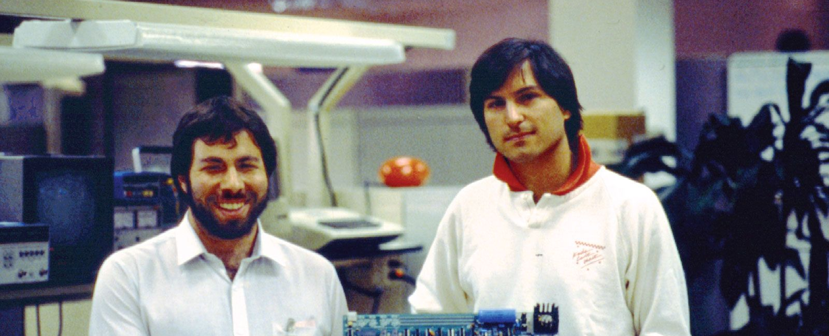
Background
Steve Wozniak attended De Anza College every quarter from summer 1969 to summer 1974, earning 114 units primarily in programming.
He and Steve Jobs (who took a PE class at De Anza) co-founded Apple Computer Inc. (now Apple Inc.) in 1976.
Jobs unveiled the Macintosh in Flint Center in 1984*
The Woz spoke at the 2014 Speakers Series.
The Woz has gifted four computers to De Anza: an Apple I with handwritten manual, two Apple IIEs (One signed), and a signed Apple Woz edition.
Gift Value ~$1Mn

Slide 3
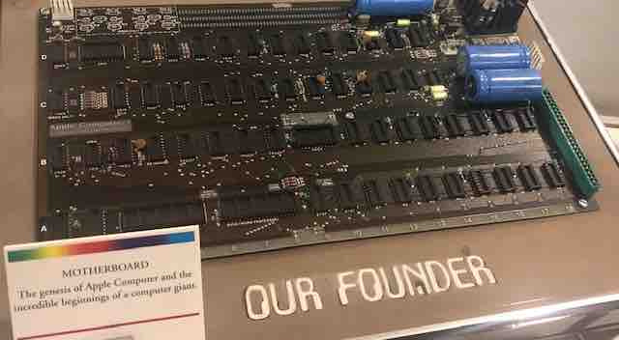
Apple I Motherboard
https://www.bonhams.com/auction/22247/lot/286/apple-1-computer-apple-1-motherboard/

Slide 4
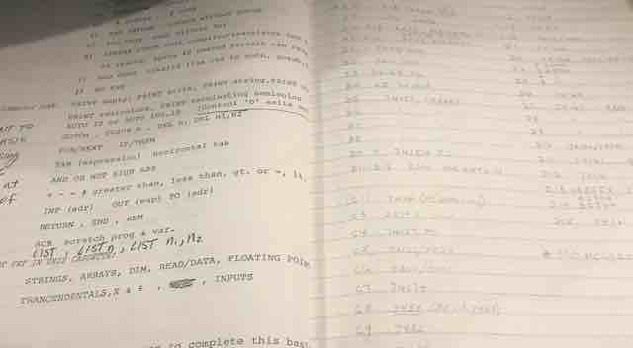
Apple I Handwritten Manual (Wozniak’s handwriting)

Slide 5
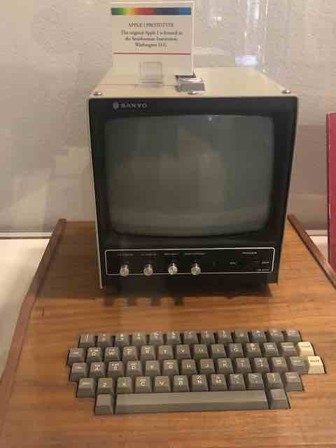
Apple I Prototype w/wooden Keyboard
https://www.dailybulletin.com/2021/11/10/rare-apple-computer-owned-by-former-chaffey-college-student-sells-for-500000/

Slide 6
Woz Affiliation
Steve is agreeable, and it would be a significant benefit to the students of our college at no additional cost.
Opportunity for a friend and fundraiser event
Takes advantage of Woz’s 5-yrs @ De Anza
Honors the “father” of the PC and recognizes his generosity to De Anza
It would tell our students, “This is where Steve Wozniak studied computers.” This is our most famous graduate, whose work has transformed the way the world conducts its daily lives. (Pres. Torres will award an honorary degree at the unveiling.)

Slide 7
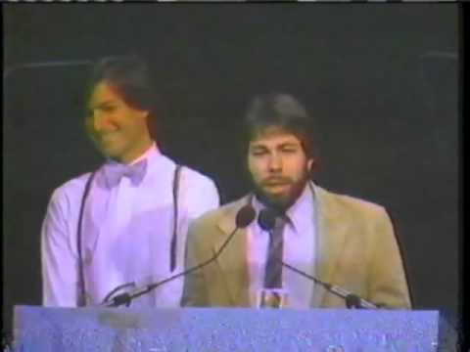
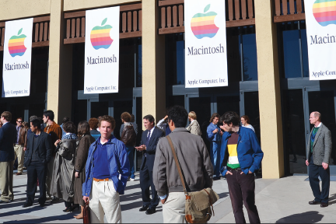
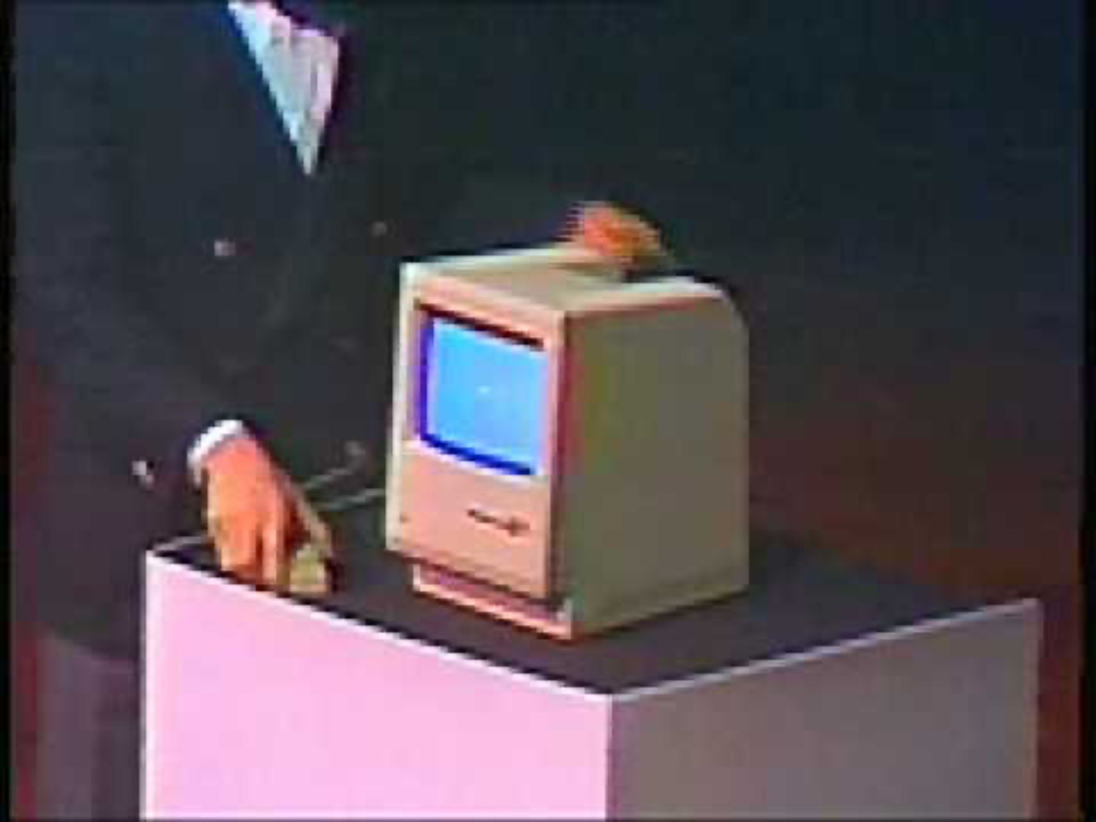
Jobs and Woz Unveiling of the Macintosh - Flint Center, 1984
https://www.youtube.com/watch?v=2B-XwPjn9YY

Slide 8
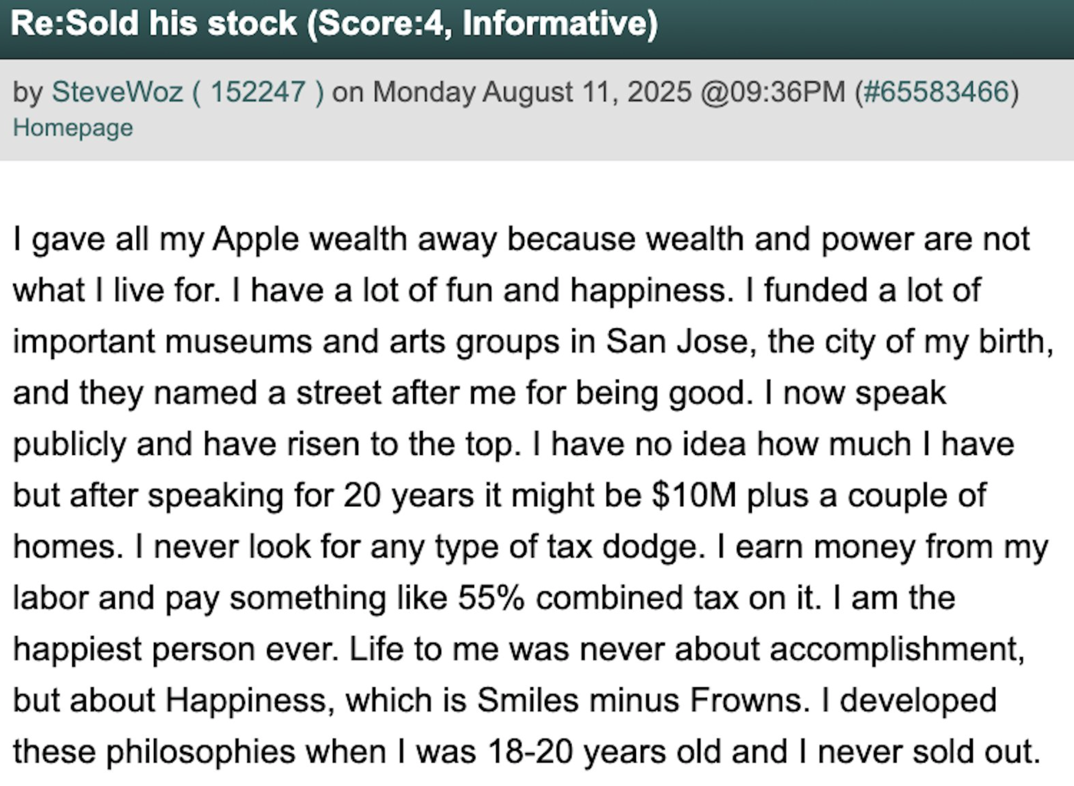
Background- Recent Quotation from Steve Wozniak on his 75th Birthday

Slide 9
“"Reconnecting” with Apple—The Woz Team
Members: President Torres, Dennis Cima, Melanie Reilly, John Swensson, Ben Dubin,
Ask Apple through Mike Foulkes* if they would consider, in honor of Wozniak’s study, funding (1) a Wozniak Chair in Computer Sciences or Film/Television, (2) student scholarships, and/or (3) an emergency grant for homeless students. (Estimated ask of $100K - $500K)
Mike Foulkes, Director, State and Local Government Affairs, Apple, Inc., coordinated Apple’s $500K unrestricted donation to De Anza in August 2014
Heavy PR. to benefit the school

