Slide 1




Realignment Plan: Faculty Survey
De Anza Academic Senate

Slide 2
How well have Academic Senate realignment conversations addressed faculty concerns?
Notes:
More transparency: Clear rationale, timelines, and updates.
Earlier involvement: Consult faculty before decisions are drafted.
Better two-way communication: More Q&A, small-group listening.
Close the loop: Show how faculty feedback shaped outcomes.

Slide 3

Faculty Voices: The Key Takeaways

Slide 4
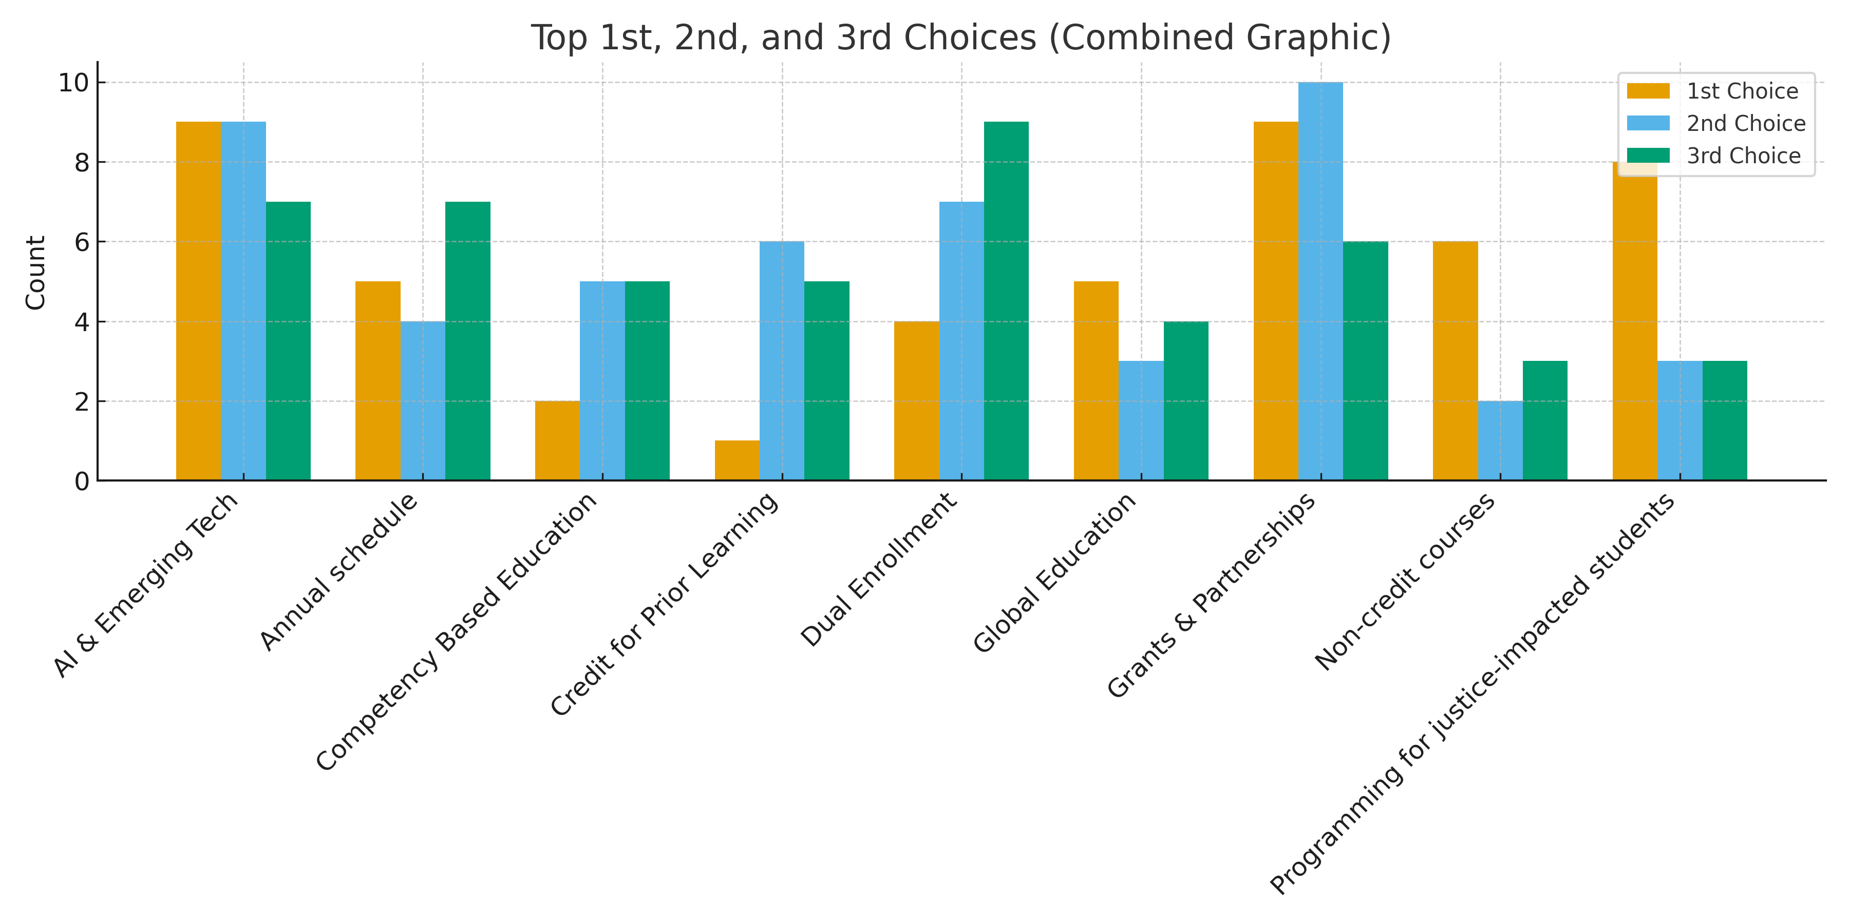
Align administrative priorities with Vision 2030 + 100 Days of Listening
Notes:
1st Choice (Most Common #1 Ratings)
Grants & Partnerships – 9
AI & Emerging Tech – 9
Programming for Justice-Impacted Students – 8
2nd Choice (Most Common #2 Ratings)
Grants & Partnerships – 10
AI & Emerging Tech – 9
Dual Enrollment – 7
3rd Choice (Most Common #3 Ratings)
Dual Enrollment – 9
Annual Schedule – 7
AI & Emerging Tech – 7

Slide 5
Faculty-Identified Valuable and Feasible Plan Components
Notes:
We have a few faculty coordinators and some things need administrative overview.

Slide 6
What factors are important to address in any future proposed realignment?

Slide 7

Clarity, Honesty, Consistency

Slide 8
Which area most needs improvement moving forward?
Notes:
Other: Better rationale, Clearer goals, All, New plan proposal, a combination of 1 and 2

Slide 9
What specific steps would help rebuild trust between faculty and administration?
Transparency & Clear Communication
Early notice, written updates, clear rationale, no more surprises or summer rollouts.
Authentic Early Faculty Involvement
Engage faculty at the start, use shared governance properly, co-design proposals.
Accountability & Repair
Acknowledge missteps, genuine apology, commit to no repeat of past processes.
Ongoing Two-Way Engagement
Regular forums, division visits, small-group conversations, opportunities for feedback.

