Slide 1


De Anza CONNECT
An Integrated Approach to Student Success:
Expansion & Updates
  Sushini Chand, Ed.D.
  September 2025

Slide 2
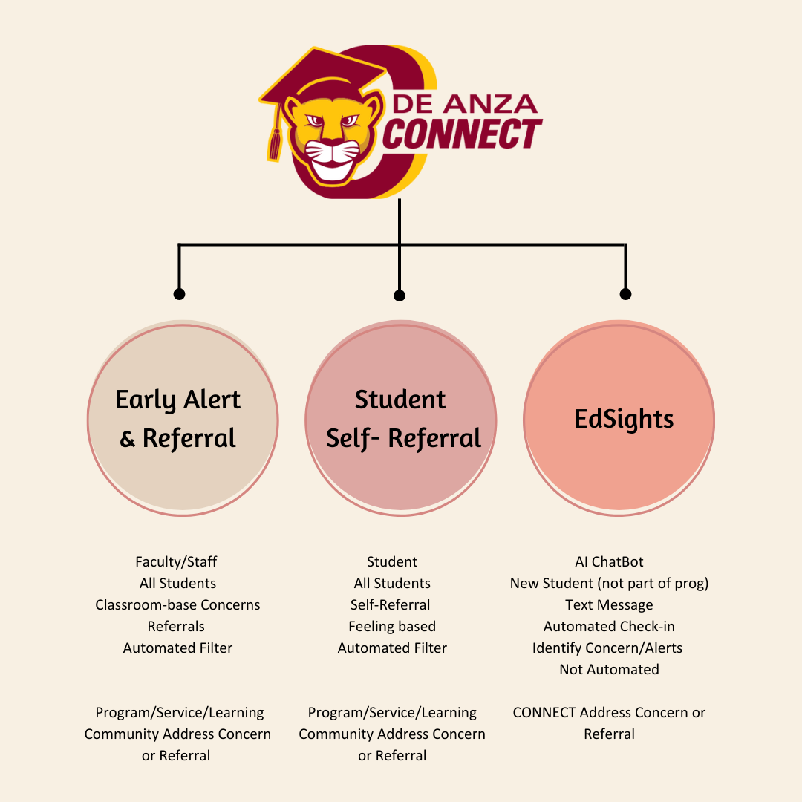

New Fall 2025

Slide 3
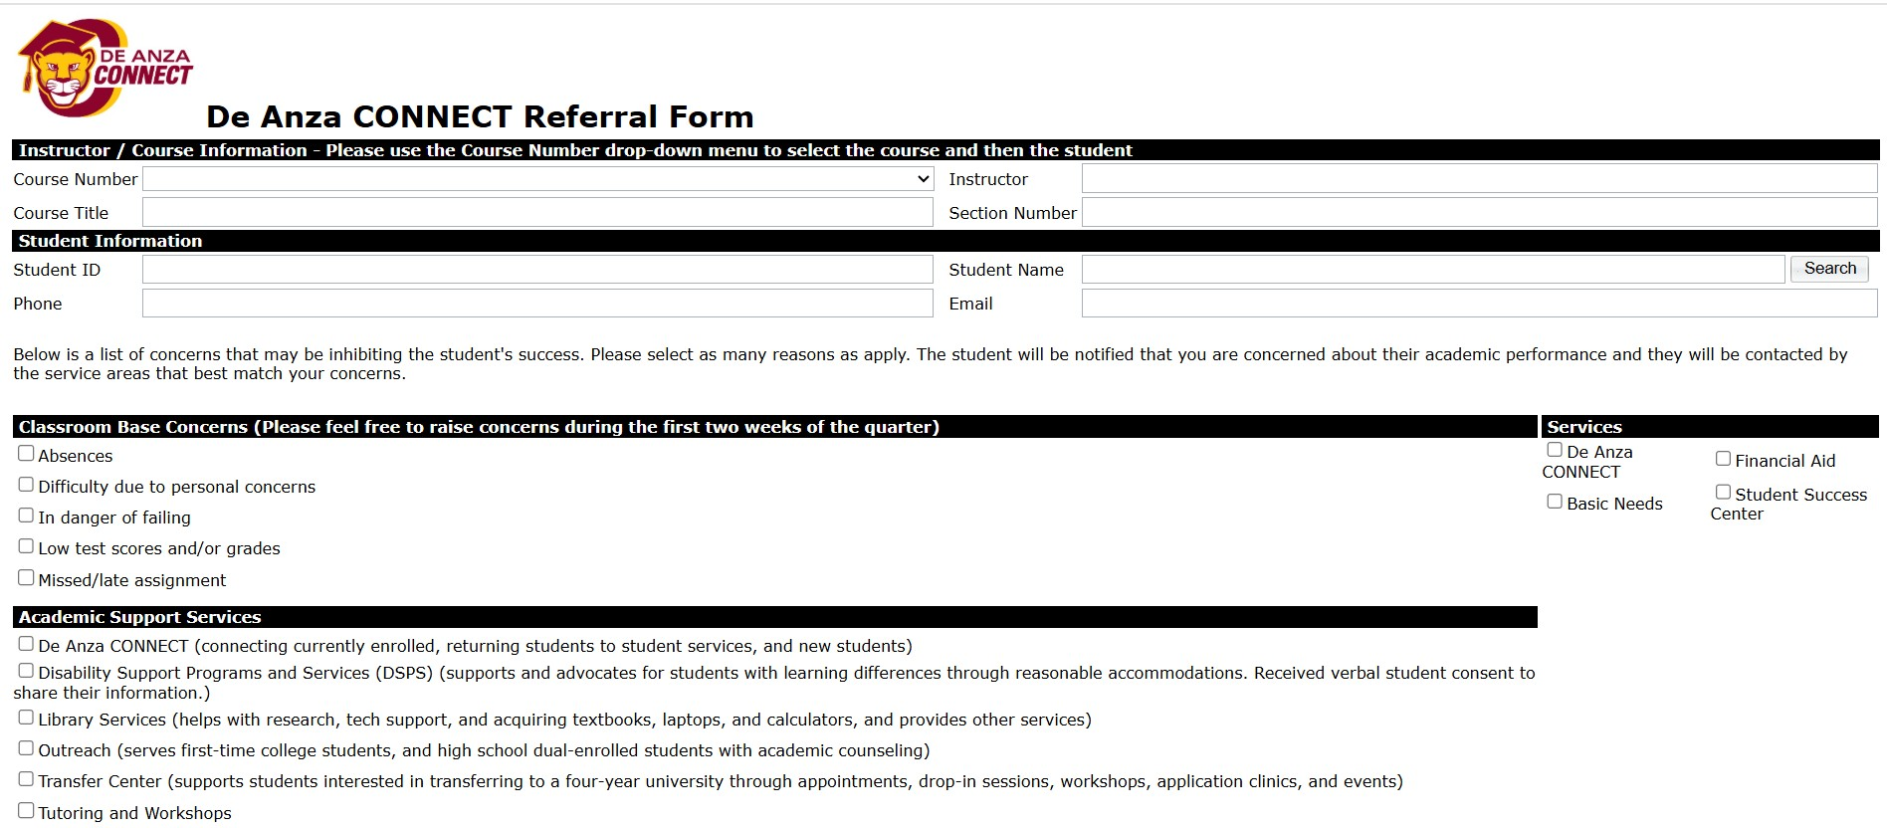


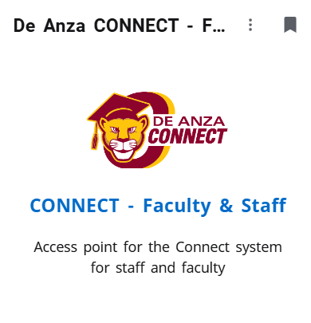

Early Alert & Referral Form
Proactive identification of students who may need support
Faculty & Staff refer students for timely intervention
Programs/Services/Learning Community Address Student referrals
RSI, VAR, Other data

Slide 4
Early Alert & Referral Form
2023-24 AY:
  3,248 concerns, referrals, and kudos
  Number of faculty staff: 130: 94 faculty; 36 staff
  CONNECT Students : 426
  Course Success:
    SP24 (faculty/staff): 63%
    SP24 (student-self referral): 78%
2024-25 AY:
  3,512 concerns, referrals, and kudos
  Number of faculty staff: 169: 130 faculty; 39 staff
  CONNECT Students : 325 (additional 650+, 2.00 - 2.29 GPA)
  Course Success:
    SP25 (faculty/staff): data pending
    SP25 (student-self referral): none

Slide 5
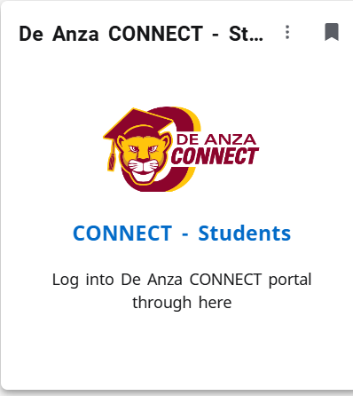
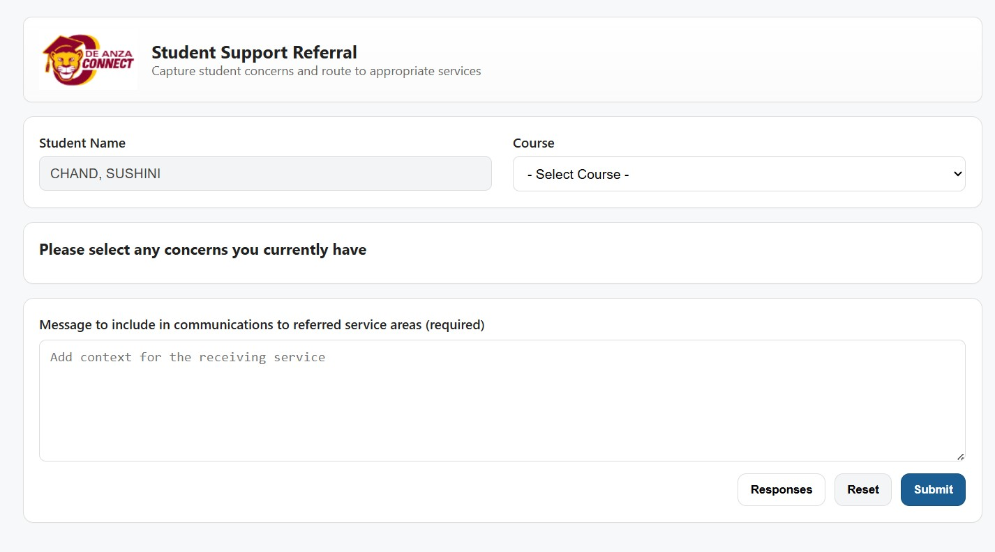
Student Self-Referral
Students self-refer
A centralized hub for asking questions or raising concerns.
Promote proactive student engagement & timely interventions
Programs/Services/Learning Community Address Student referrals

Slide 6
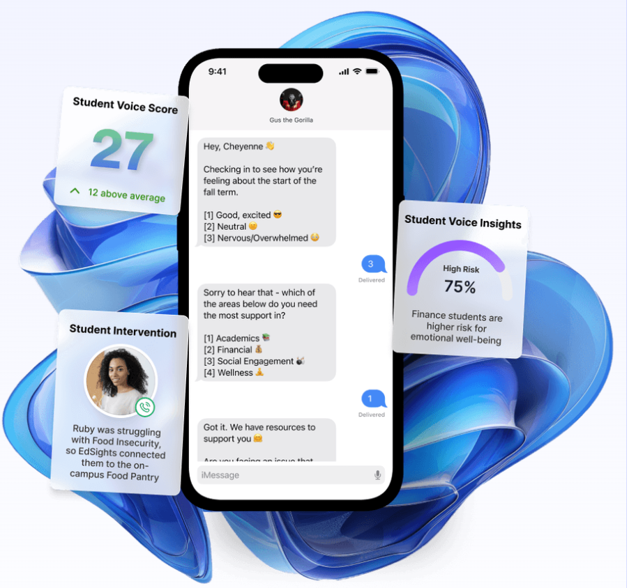
EdSights
New Students
  not part of program/service/learning community
AI-driven communication tool
  Checks-in with students periodically throughout the quarter
Actionable insights to support retention and success.
Concerns are addressed by CONNECT Team

