Slide 1
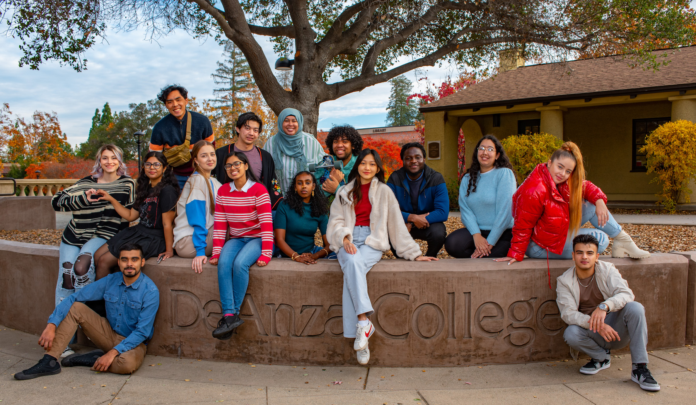
Campus Climate Survey

Slide 2
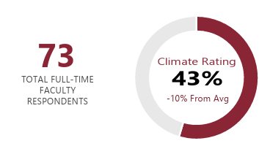
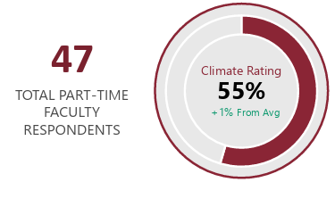
Survey Highlights
Survey administered in Spring 25
Evaluates campus climate across engagement, belonging, leadership, and transparency (4-point scale)
Total Respondents: 73 full time faculty and 47 Part Time faculty.

Slide 3
Highest Rated Responses: PT
Engagement
I am actively engaged at work – 97%
I have professional goals and know how to achieve them. – 88%
Institutional Effectiveness
Promoting student well-being – 79%
Campus Safety
I feel safe on campus when it is light out – 96%
I feel safe in my workspace/classroom – 87%

Slide 4
Highest Rated Responses: FT
Engagement: I am actively engaged at work - 100%
Belonging / Community: I feel connected and part of the community - 89%
Equal Opportunity: Access resources and services to support my professional growth - 71%
Institutional Effectiveness: Ensuring the principles of diversity, equity, inclusion, and accessibility are woven throughout the institution - 78%
Shared Governance Leadership: My constituency leaders operate transparently - 77%
Decision-Making Process: I recognize the importance of these decision-making processes in shaping our direction and policies - 87%

Slide 5
Reflective Discussion
Both full-time (100%) and part-time (97%) faculty report feeling highly engaged at work.
In a few words, what practices or conditions most drive your engagement at work?
How can we ensure these factors are shared across all areas of the college?

Slide 6
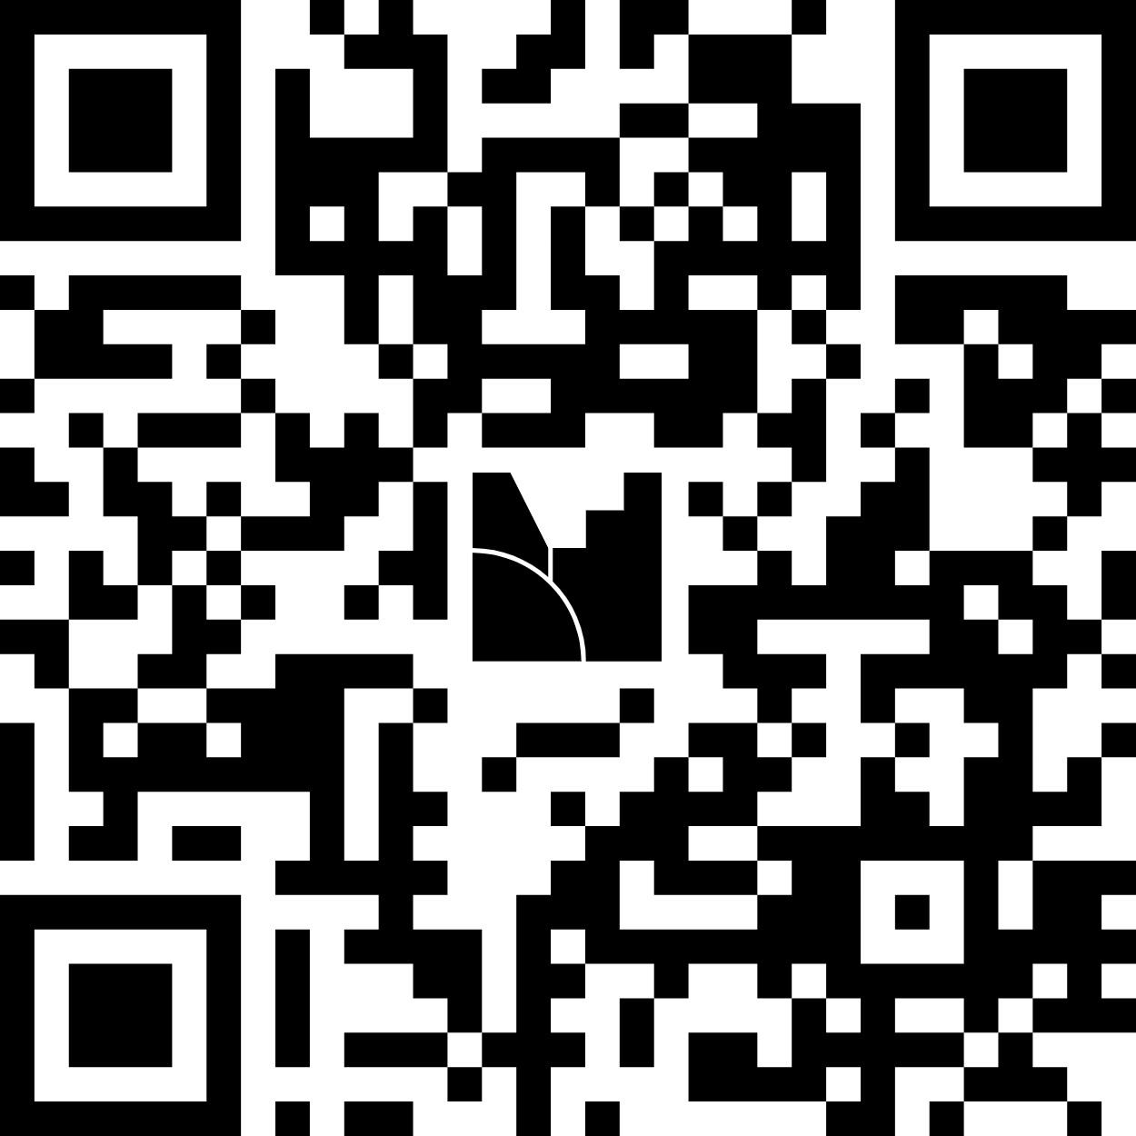
Mentimeter Code: 5774 1926

Slide 7
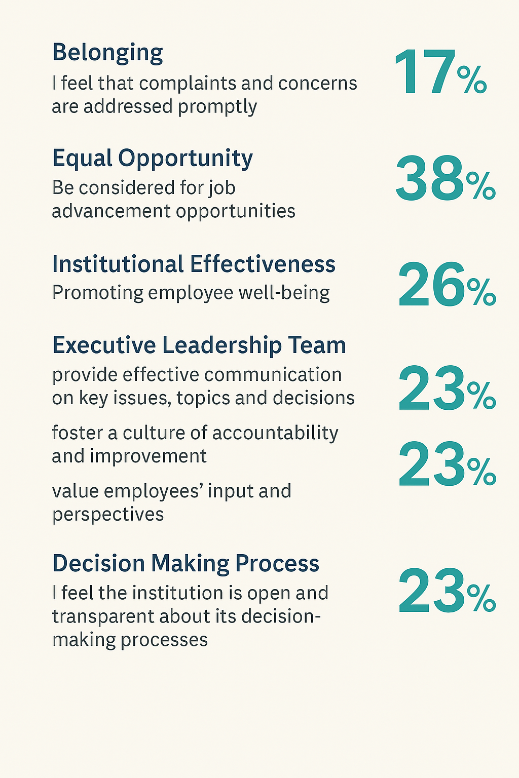
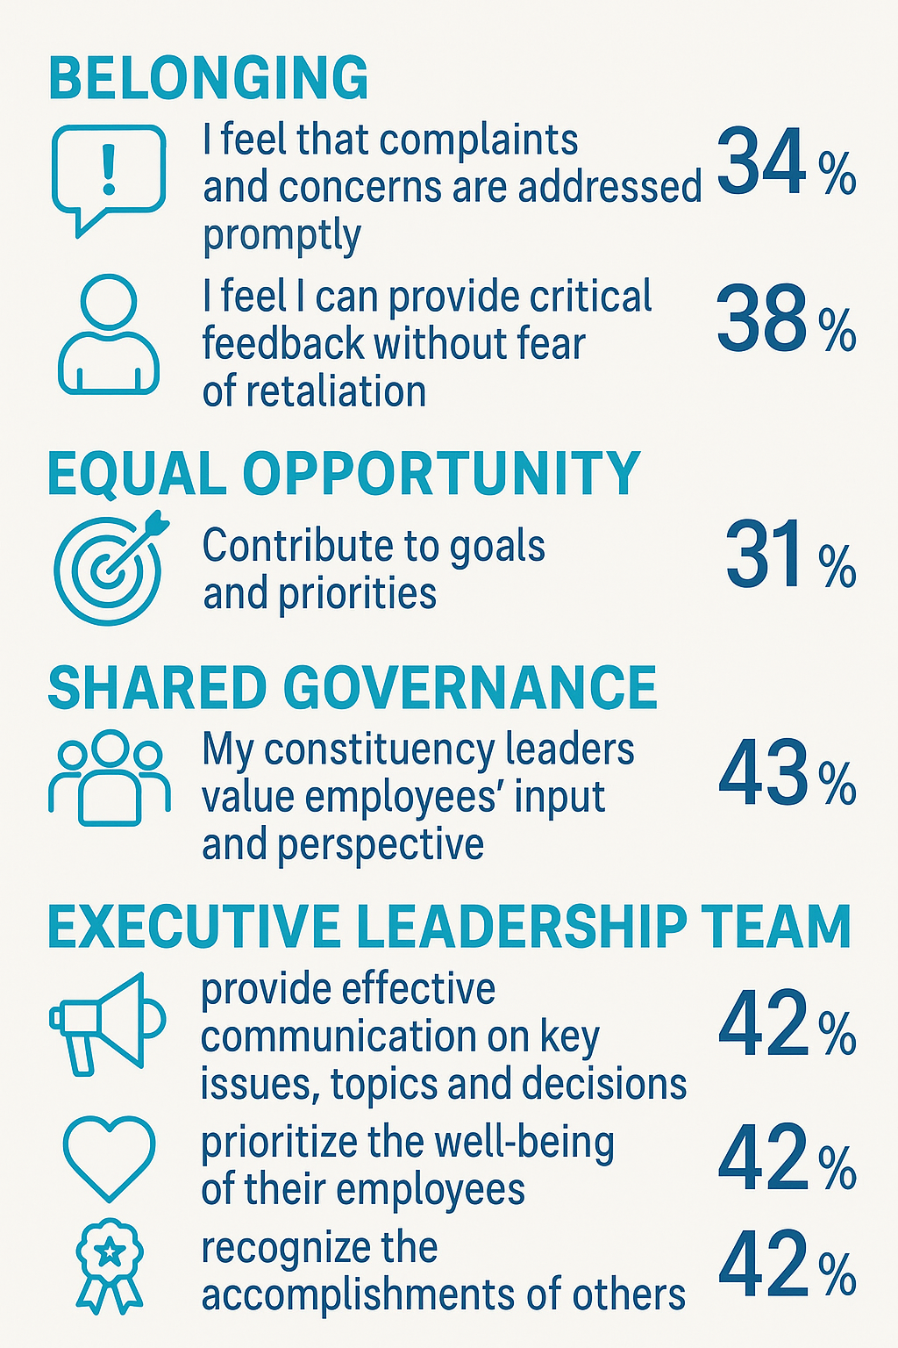
Opportunities
Full Time
Part Time

Slide 8
Reflective Discussion
Survey results show low confidence in addressing concerns (17–34%), limited transparency in decision-making (23%), and weak communication from leadership (23–42%), underscoring the need for greater trust, accountability, and equitable opportunities.
What barriers or challenge most affects your sense of belonging, professional growth, or trust in leadership?
What actions or changes would most help improve communication, trust, and well-being across employee groups—especially in leadership accountability, transparency, and opportunities for advancement?

Slide 9
Mentimeter Code: 5774 1926

