Slide 1
Annual Schedule
Ram Subramaniam, 11-17-2025

Slide 2
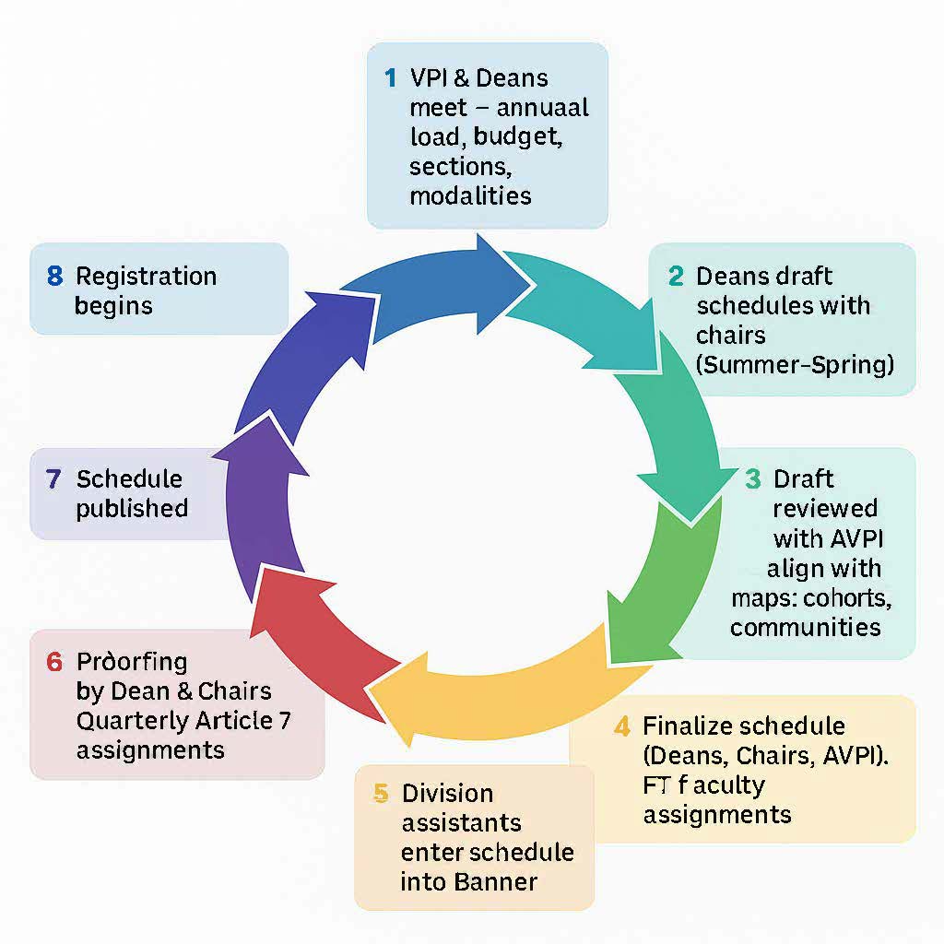

Slide 3
Stage 1: Deans and VPI discuss total division load, numbers of sections, and distribution of modalities. November 2025
Stage 2: Deans should work with Department Chairs and develop the draft spreadsheet with course offerings for each department for all four quarters. November- January 2026
Stage 3: Each Dean will submit their draft spreadsheets to the AVPI who will work with each division Dean along with help from a couple of Deans to align the drafts with Guided Pathways Program Maps, Learning Community offerings, Cohort programs. February 2, 2026
Stage 4: Deans will finalize the schedule spreadsheets. Share the spreadsheets with the departments. Assign FT faculty assignments for the year. May 1- May 10th
Stage 5: Division Administrative Assistants enter the schedule in Banner. June 1st- June 8th, 2026
Stage 6: Deans and Department Chairs will proof the schedule and make any changes needed. June 1st- June 8th, 2026
Stage 7: Scheduling Office will publish the schedule. June 22, 2026
Stage 8: Students enroll for classes. July 20, 2026

