Slide 1
Administrative Realignment Proposal: Part 2
Ram Subramaniam
October 6, 2025

Slide 2
Two Major Sources
De Anza College: President Torres’s 100 days of listening- Nine themes with key points and important opportunities
  Reference: https://www.deanza.edu/president/100-days/index.html
Chancellor’s Office Vision 2030
  Reference: https://vision2030.cccco.edu

Slide 3
Major Themes
Vision 2030
Equity & Access
Workforce Development
Technology & Innovation (AI, CBE, digital literacy)
Sustainability & Resilience
100 Days of Listening
Student Success: equity, belonging, basic needs
Faculty & Staff Support: workload, innovation, collaboration
Partnerships & Community: K-12, industry, civic engagement

Slide 4
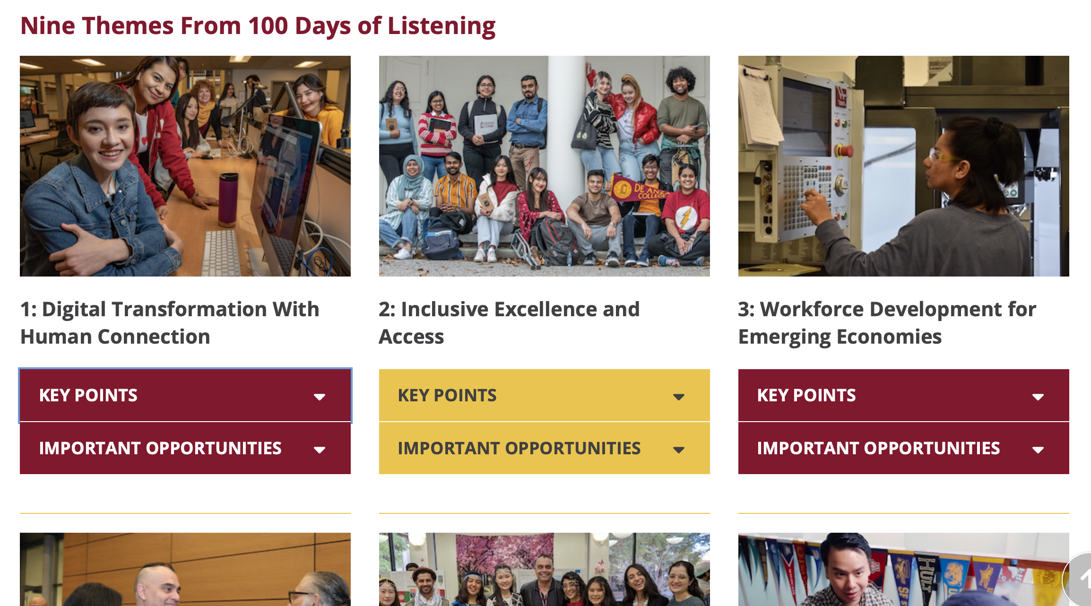

Slide 5
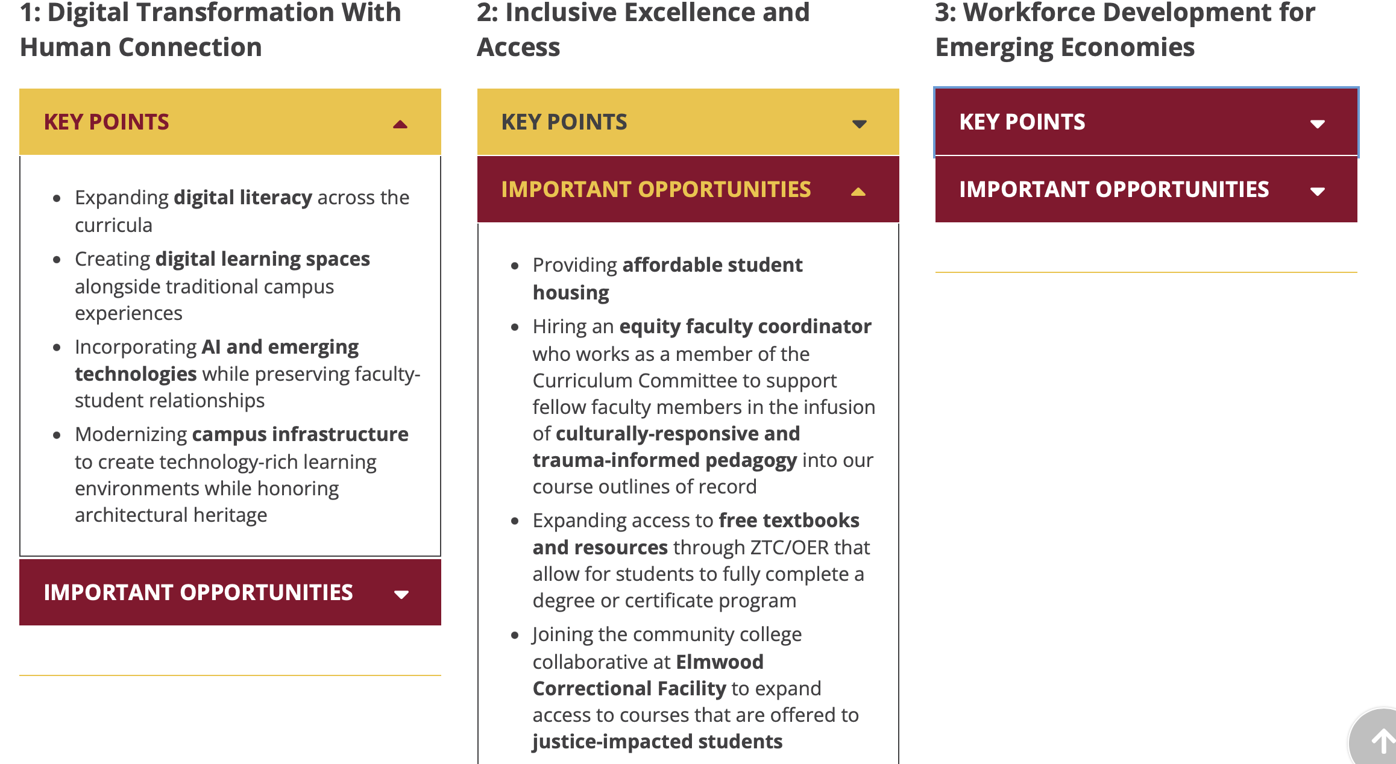

Slide 6
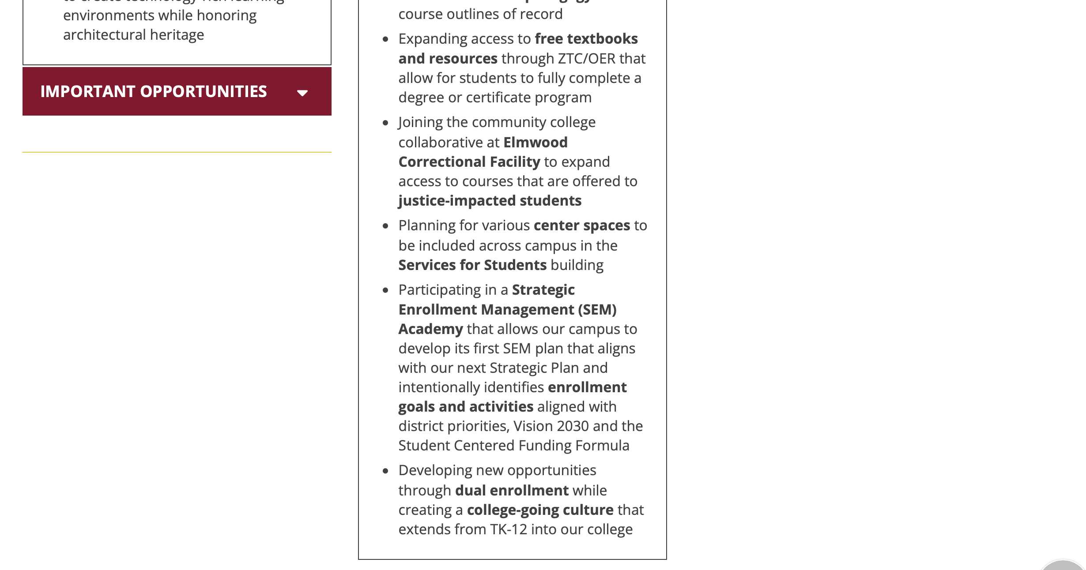

Slide 7
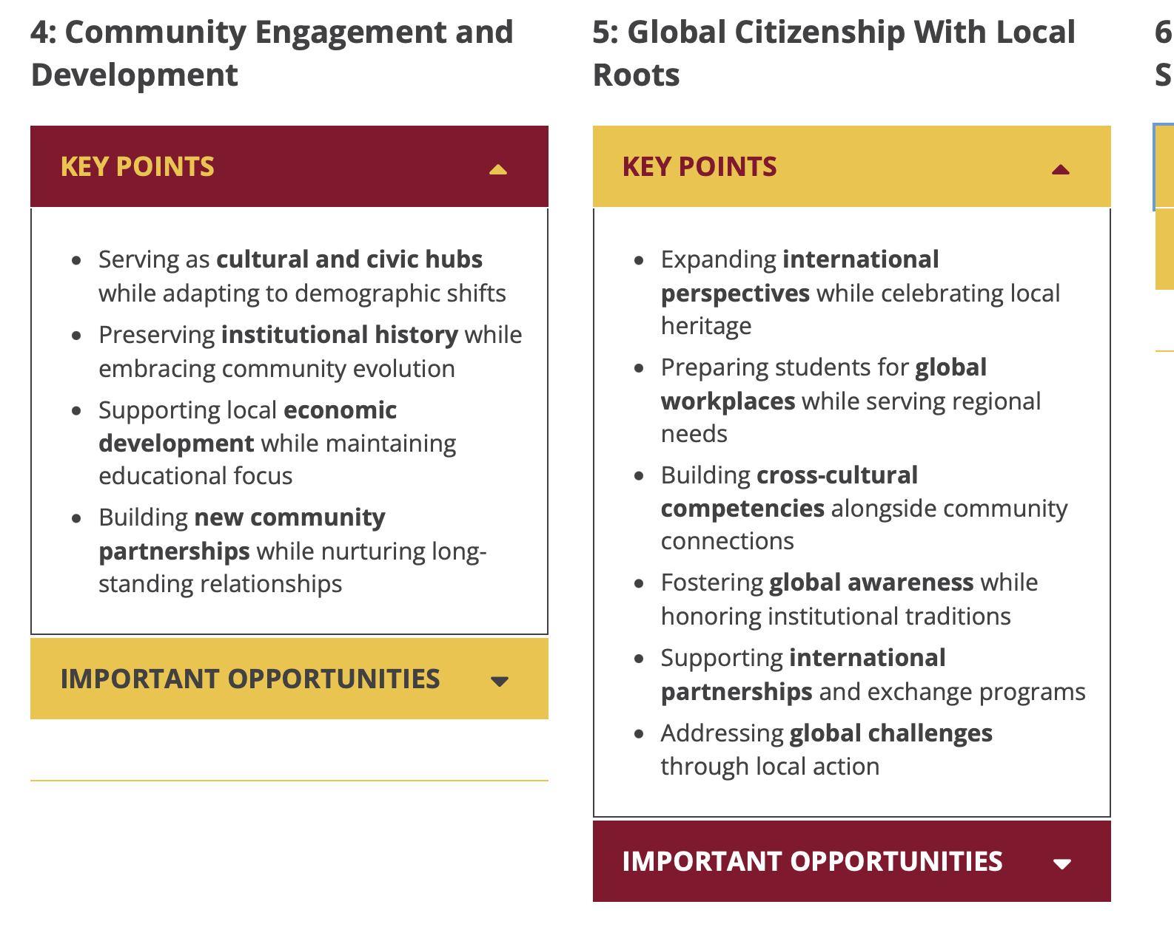

Slide 8
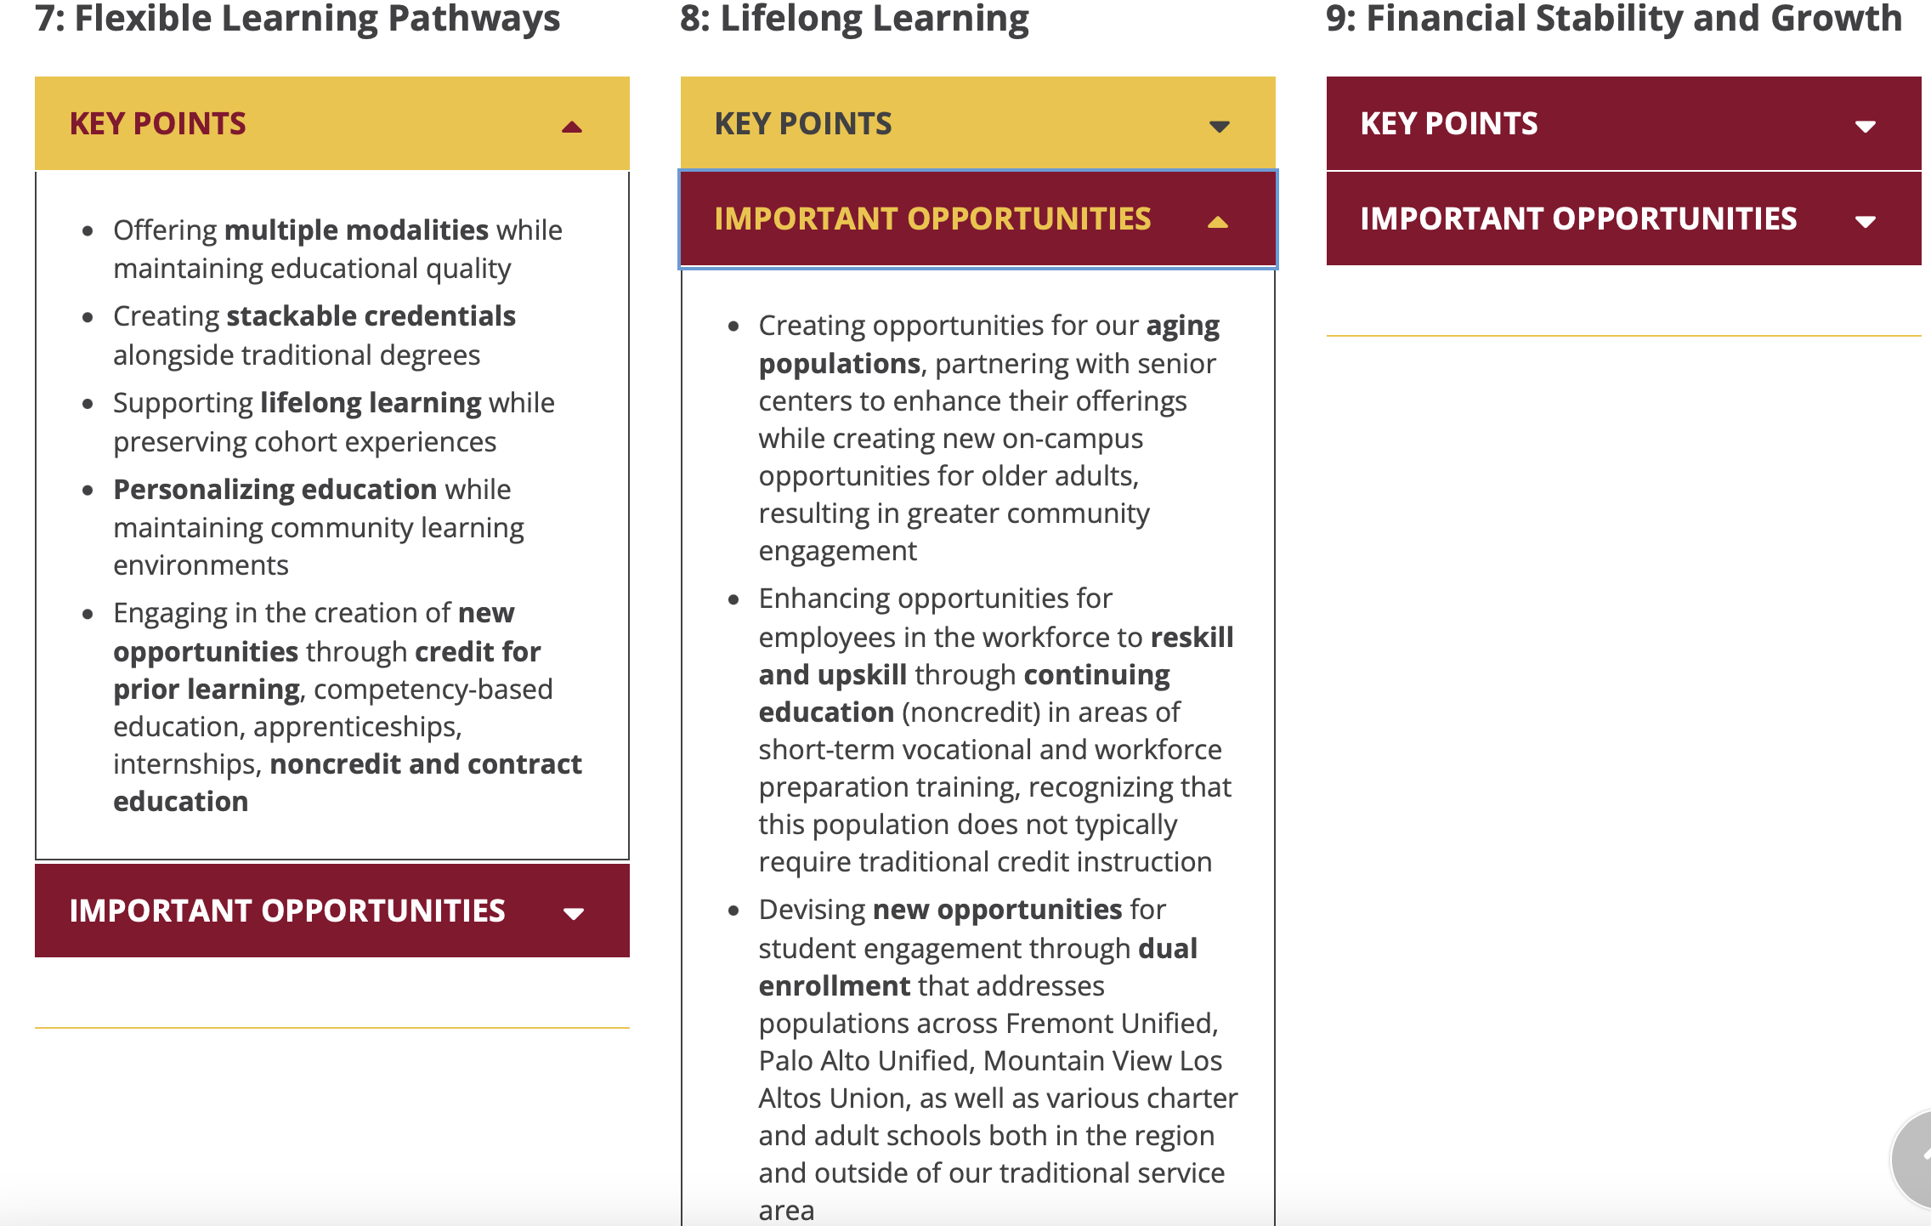

Slide 9
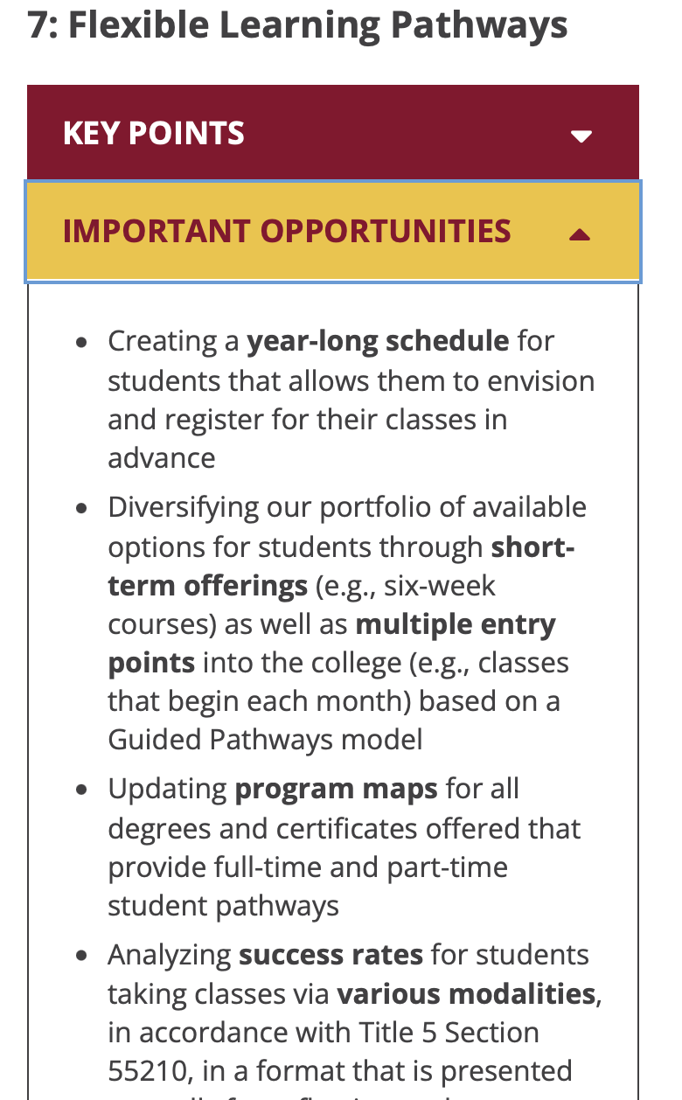
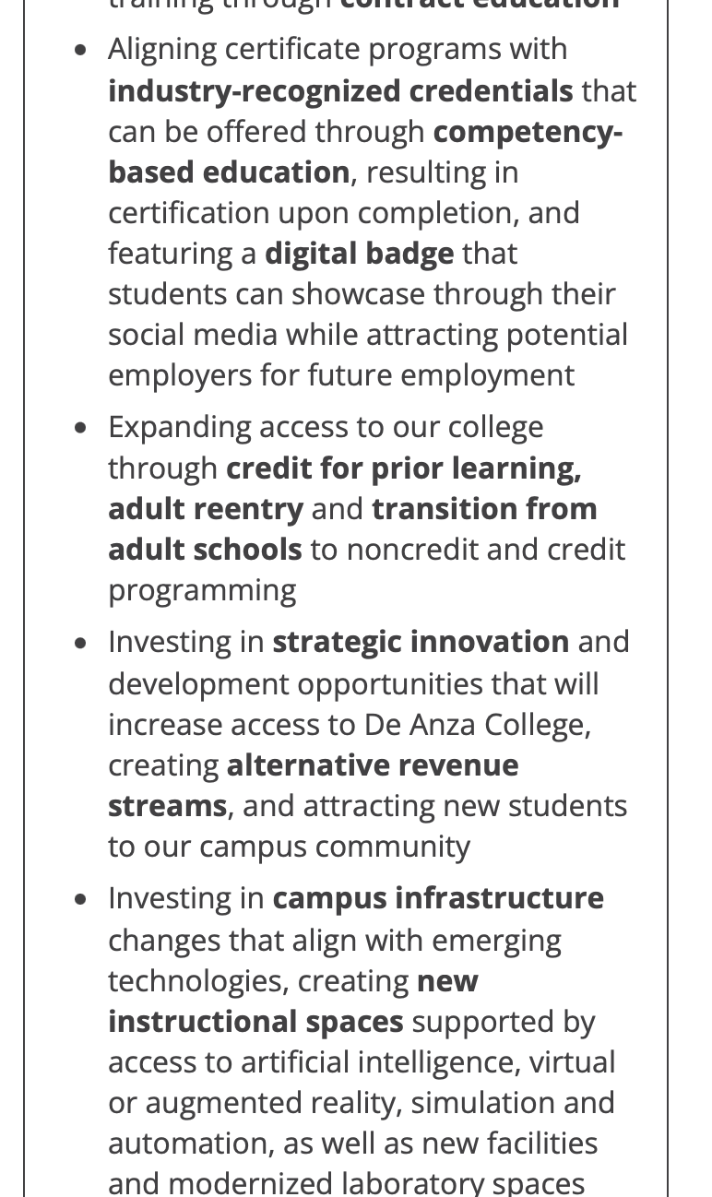

Slide 10
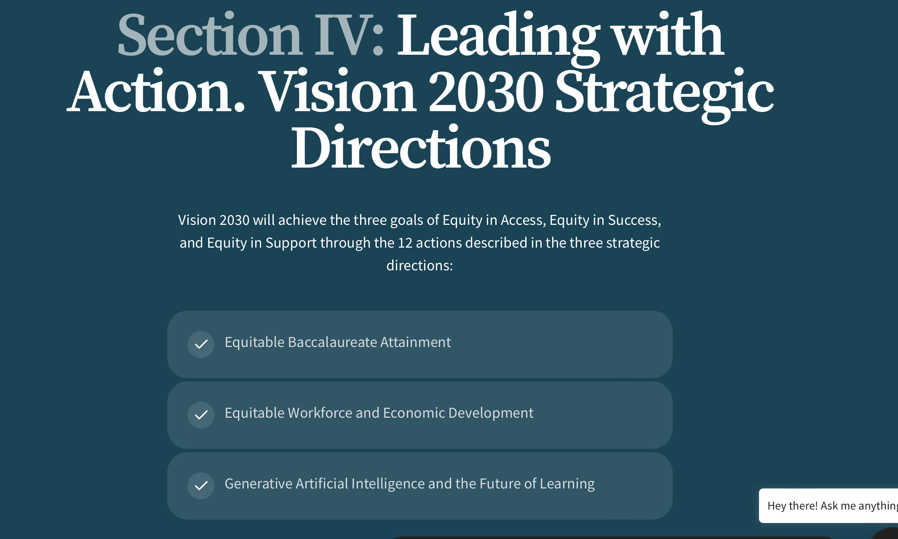

Slide 11
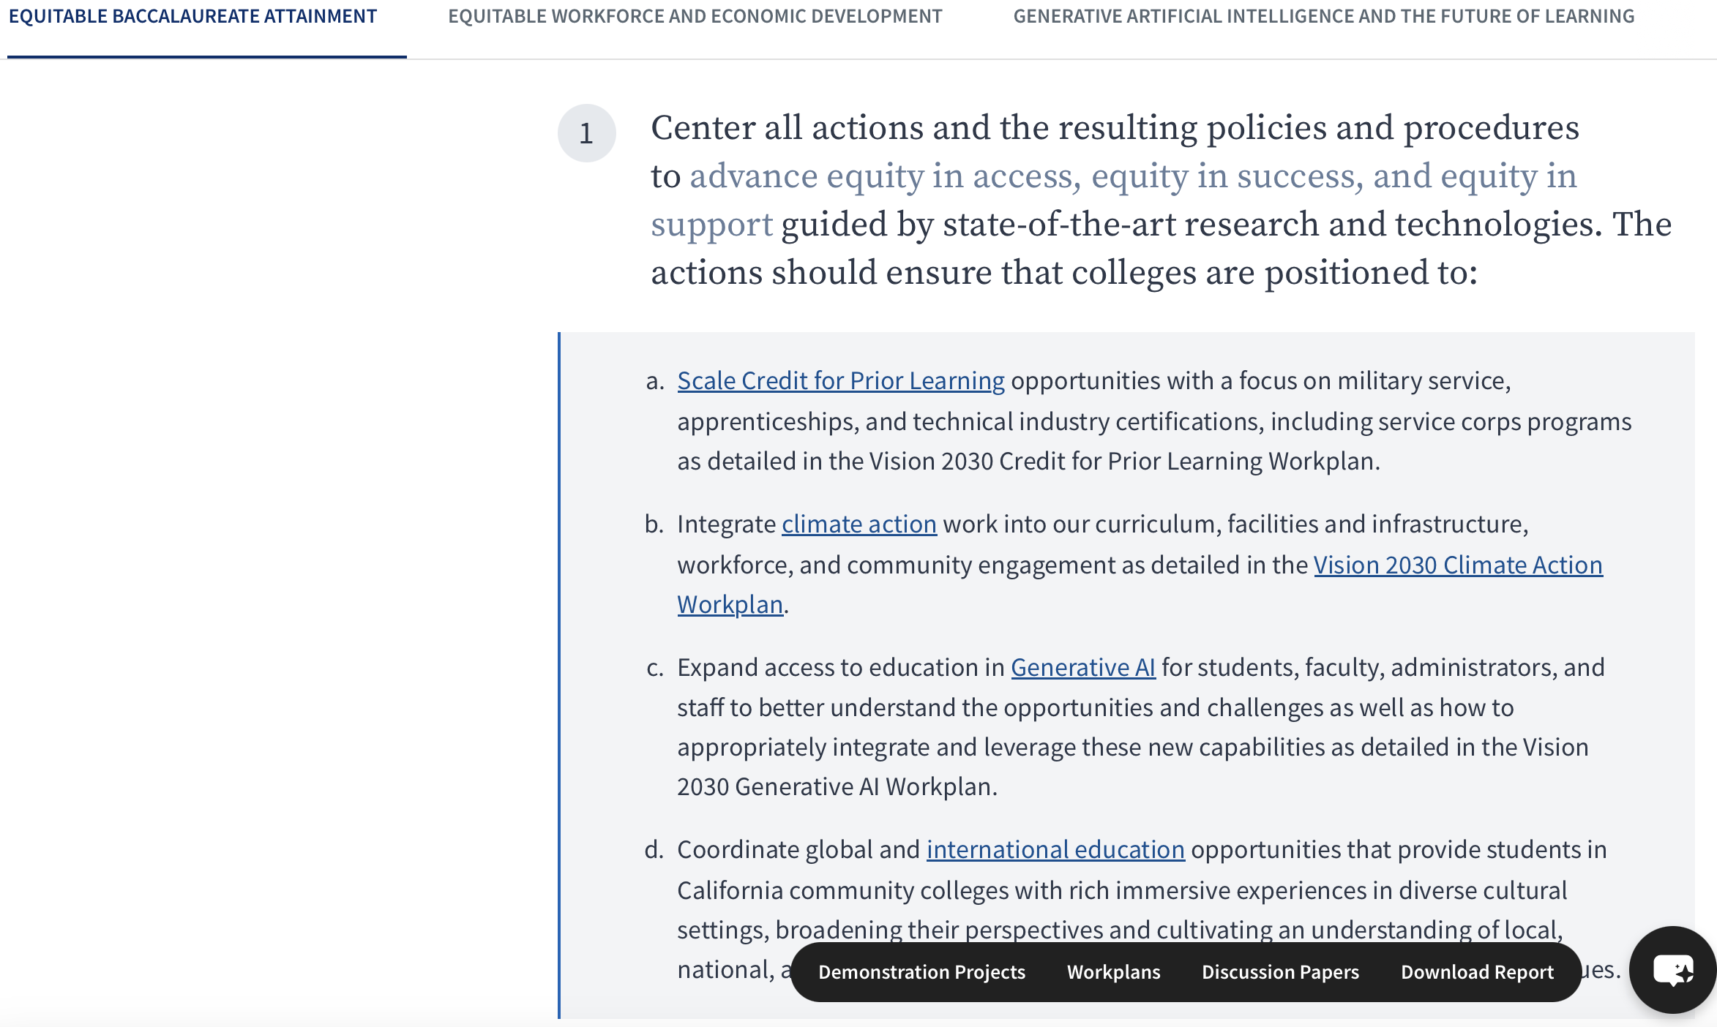

Slide 12
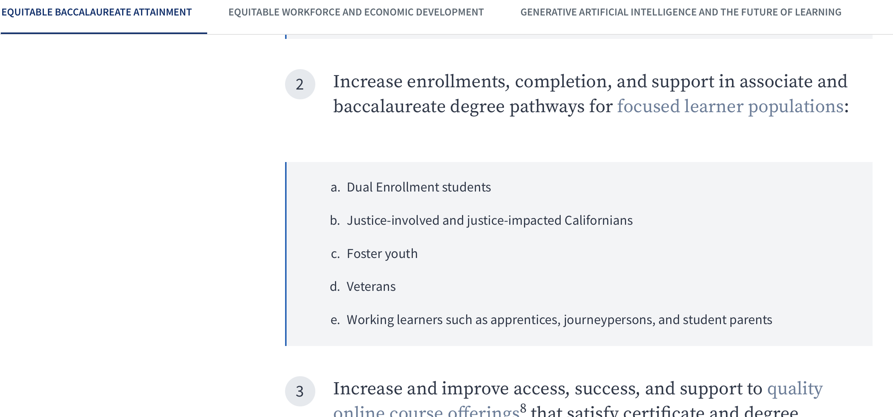

Slide 13
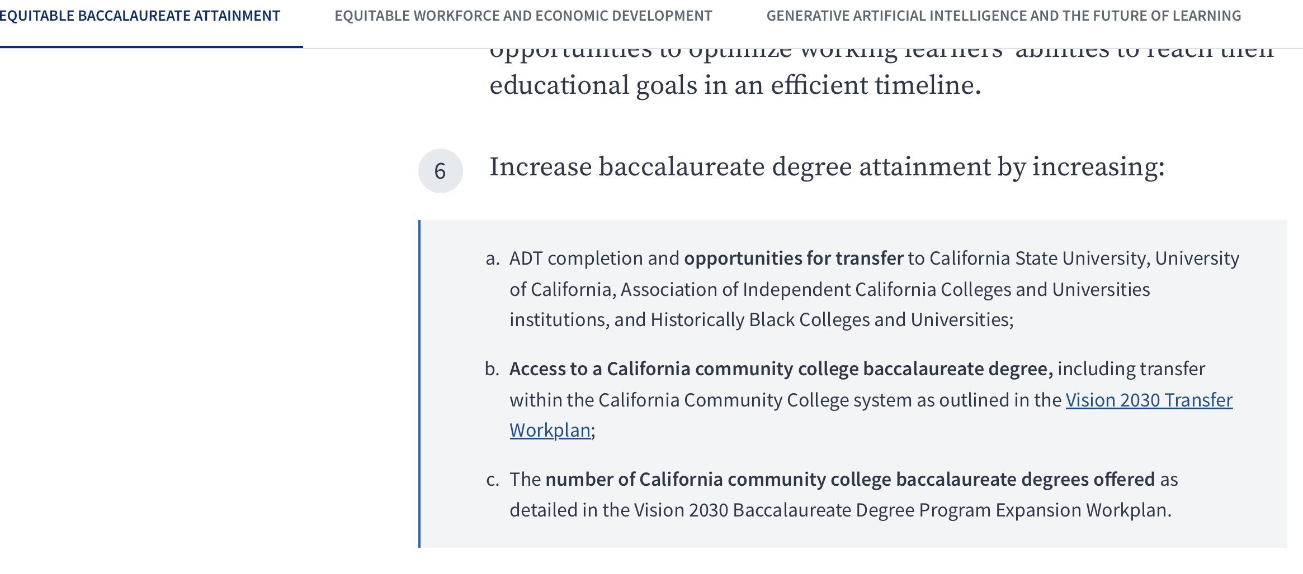

Slide 14
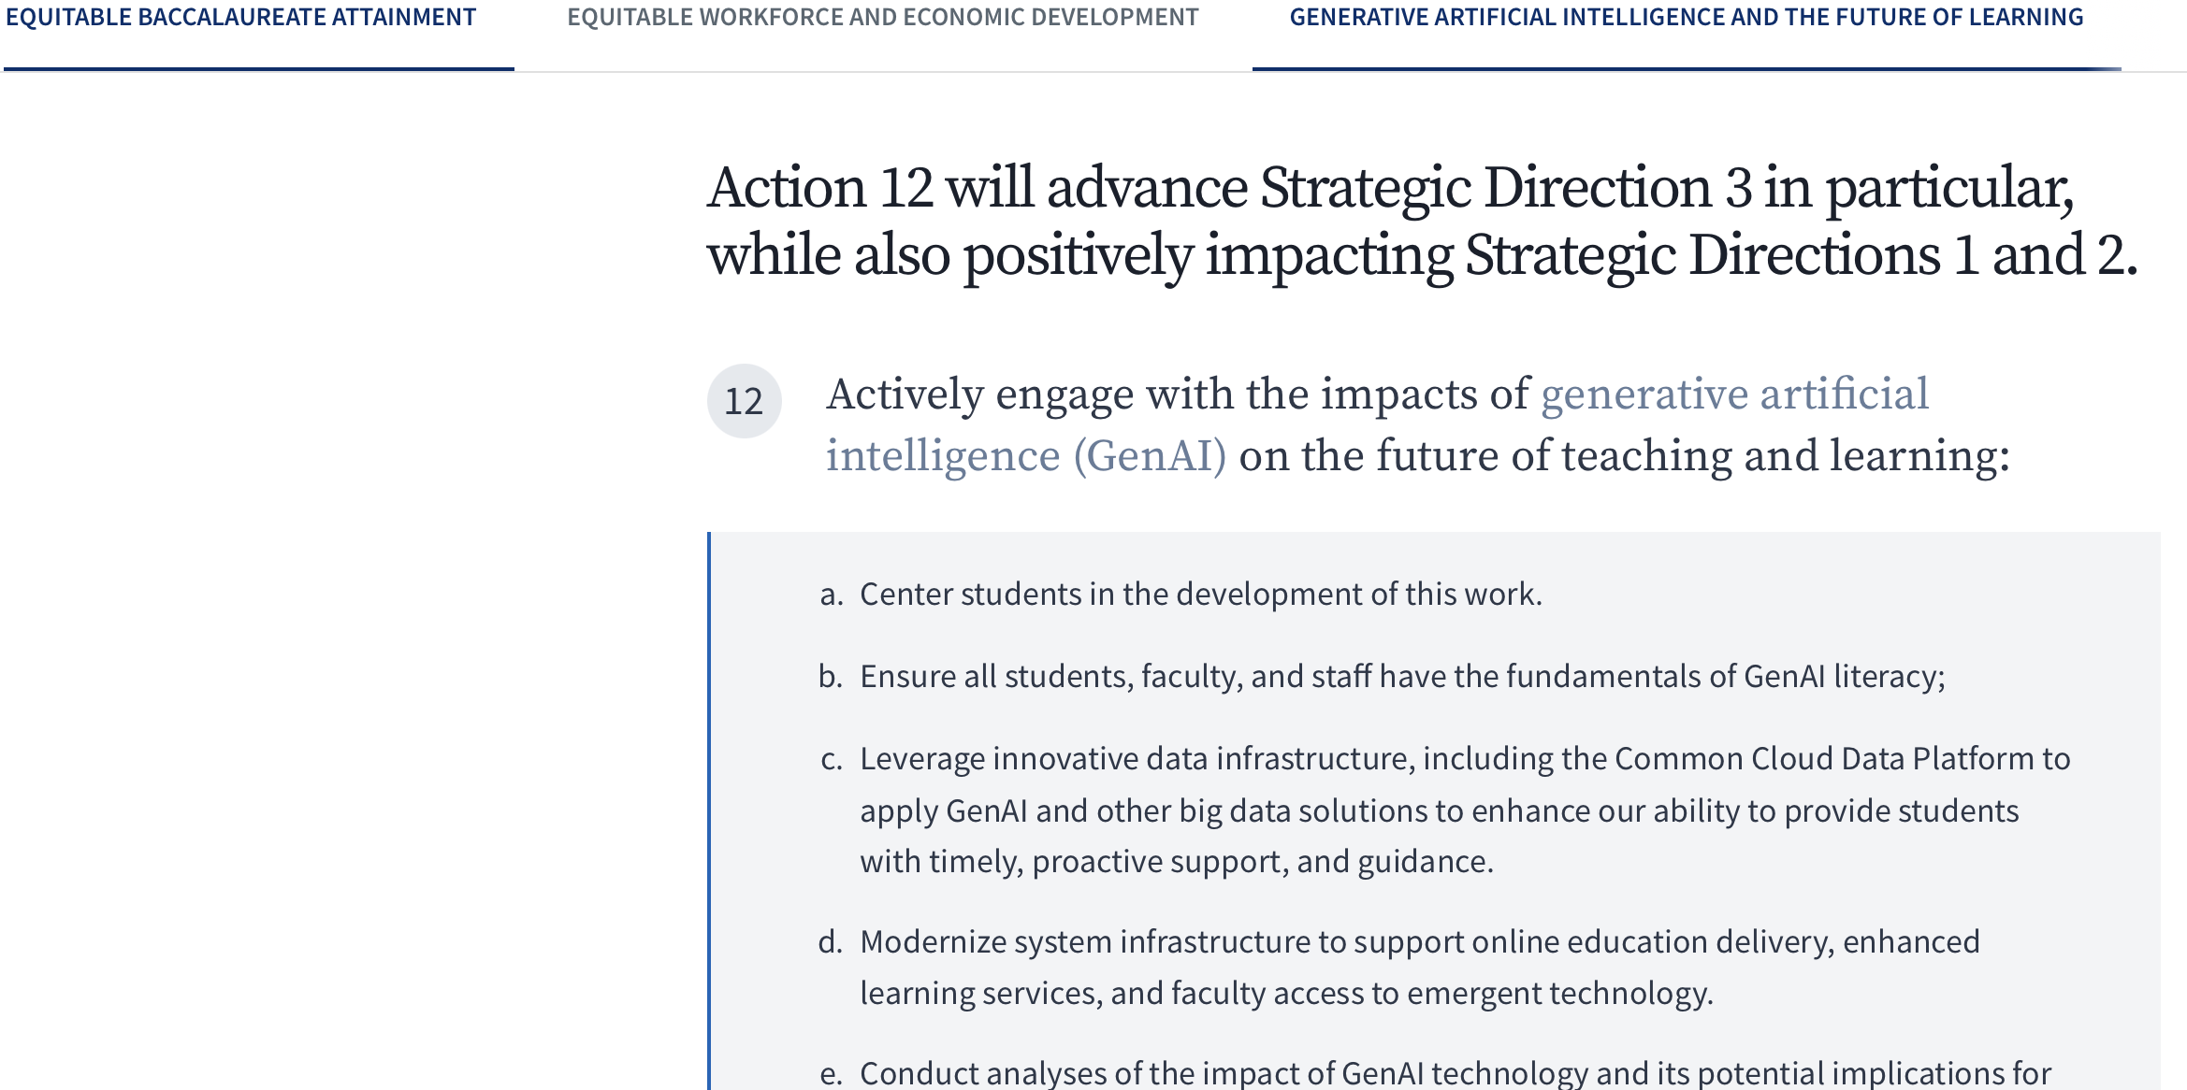

Slide 15
Administrative Functions
Duty | Vision 2030 Alignment | 100 Days Alignment
Dual Enrollment | Early College Credit | Stronger K–12 ties
AI & Emerging Tech | Innovation in Learning | Preparing students for future jobs
Grants & Partnerships | Workforce Development | Community partnerships
Global Education | Global Competitiveness | International perspectives
Year-long schedule | Guided Pathways | Student scheduling flexibility
Credit for Prior Learning | Shorten time to completion | Recognizing student experience
Annual Schedule | Equity in access | Flexible learning pathways
Non-credit | Equity in access | Flexible learning pathways
Programming for justice-impacted students | Equitable baccalaureate attainment | Inclusive excellence and access
Competency Based Education | Equity in success | Flexible learning pathways

